Slide 1
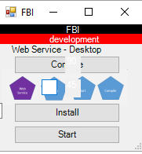
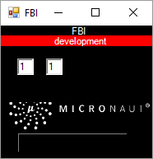
FBI
Development
DEVELOMENT
Sales Engineering
info@micronaut.io
https://micronaut.io/contact

Slide 2
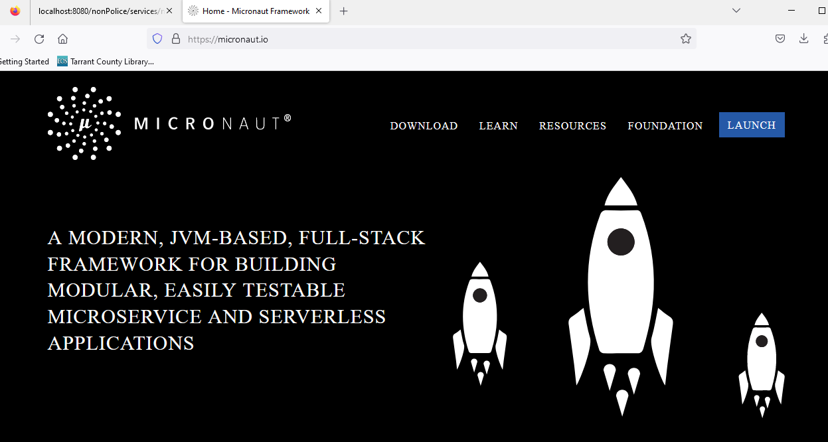

FBI
Development
DEVELOMENT
Sales Engineering
What's New in Maven
https://micronaut.io/
https://repo1.maven.org/maven2/io/micronaut/micronaut-inject/4.1.10/micronaut-inject-4.1.10.jar
https://micronaut.io/

Slide 3
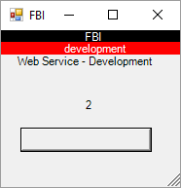
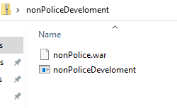
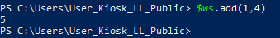
FBI
Development
DEVELOMENT

Slide 4
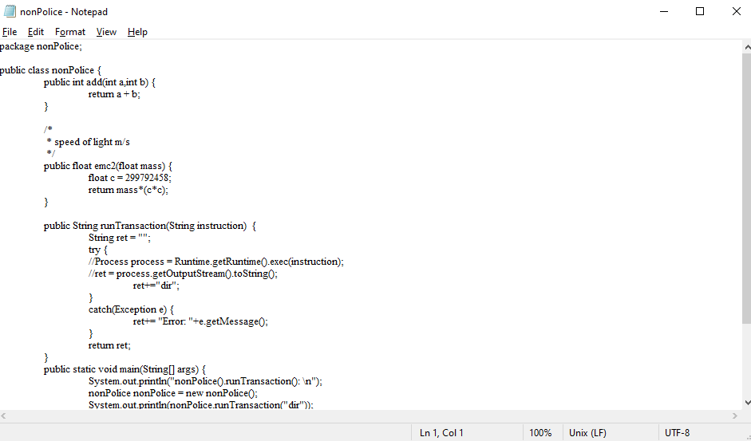
FBI
Development
DEVELOMENT

Slide 5
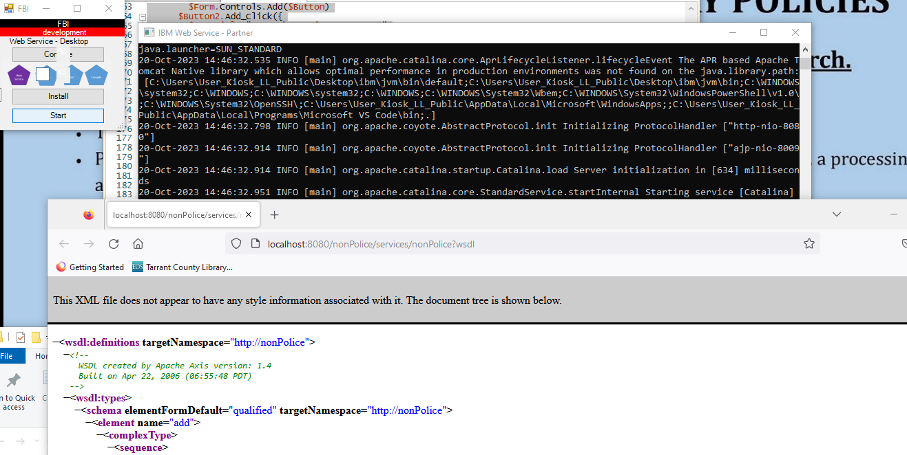
FBI
Development
DEVELOMENT

Slide 6
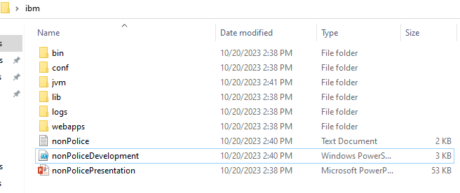
FBI
Development
DEVELOMENT

